Slide 1
Normal flora of the oral cavity

Slide 2
Bacterial Oral Flora

Slide 3
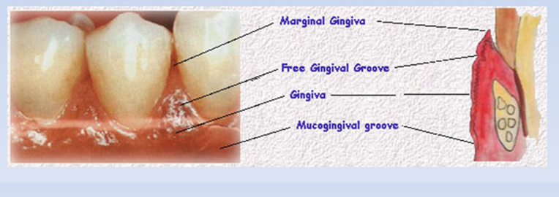

Slide 4
The presence of nutrients, epithelial debris, and secretions makes the mouth a favorable habitat for a great variety of bacteria. Oral bacteria include :

Slide 8
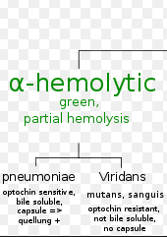
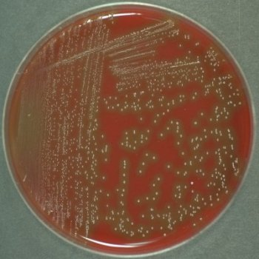
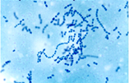
Of all bacteria present in mouth, Streptococci are predominant group.
Various species of Streptococci are encountered in mouth .
Most of these are alpha –hemolytic streptococci , collectively named as viridians streptococci.
Lactobacilli are frequently found in mouth.
They are important bacteria to promote the progress of carious lesion after the initiation of dental caries by Streptococcus mutans.

Slide 9
Acquisition of the oral flora

Slide 10
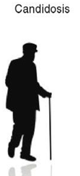

Slide 11
O
Indigenous or resident flora - species usually presented in high numbers and are compatible with the host
Exogenous flora - bacteria not part of the normal flora of the oral cavity and thought to cause disease
Transient flora - organisms which are only in the oral cavity for short period of time
Some of the normal flora are

Slide 12
Factors influencing the oral ecosystem
The growth of oral microorganisms is influenced by a variety of factors such as :
1-Temperature
2-pH
3- Oxidation –reduction potential
3- The availability of nutrients and water
5-The anatomy of oral structures
6-Host factors which include :(host defense mechanisms, age, hormonal changes , stress, genetic factors).
7-Other factors:(diet ,oral hygiene and antimicrobial agents, drug and diseases.
8- Bacterial Factors

Slide 13
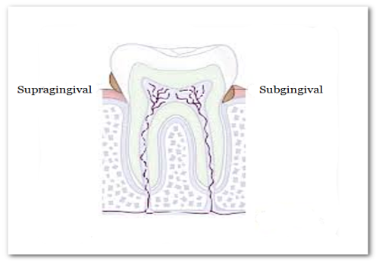
Temperature :
The temperature of the oral cavity is relatively constant
(34-36° C) which allows a wide range of microorganisms to grow . The temperature may be more variable on the mucosal and tooth supragingival surface. during food intake microorganisms exposed to hot and cold meals and may be adapt to these extreme variations of temperature.
pH:
Hydrogen ion is an important parameter in oral microbial ecology .Frequent sugar intake favors the growth of aciduric bacteria such as Lactobacillus and streptococcus mutans and predisposes to caries formation.

Slide 14
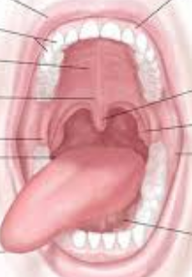
Oxidation –reduction potential
Many enzymatic reactions are oxidation-reduction reactions in which one compound is oxidized and another compound is reduced. Anaerobic bacteria need a reducing environment for growth , while aerobic bacteria need an oxidizing environment. The mouth is characterized by a wide range of oxidation-reduction potentials allowing the growth of aerobic, facultative anaerobic, and anaerobic bacteria.In general , the dorsum of the tongue and the buccal and palatal mucosas are aerobic environments which support the growth of facultative anaerobic bacteria. The gingival crevice and the surfaces between teeth will have the highest concentration of obligately anaerobic bacteria.

Slide 15
Nutrients
Saliva is an important source of nutrients from both endogenous (saliva) and exogenous (diet) origin. Saliva contain water, carbohydrates , proteins , amino acids , and several ions . Saliva can support normal growth of microorganisms in the absence of exogenous nutrients. Among exogenous dietary components, carbohydrates and proteins have the greatest influence on the composition of the oral microflora.

Slide 16
Host factors
1- Host defence mechanisms:
The supragingival environment of the oral cavity is controlled primarily by saliva . The continuous flow of saliva increased by the muscular activity of the lips and tongue removes a large number of bacteria from teeth and mucosal surfaces . Saliva also contains several specific and non specific defense factors like IgA and non specific defense factors include mucins , lactoferrin , lysozyme..etc.
2- age:
Age –related changes in the oral microflora include those due to teeth eruption , changes in dietary habits , hormons , salivary flow, the immun system , or other factors.

Slide 17
3-Hormonal changes :
It is well documented that pregnancy and puberty are associated with increase in gingival inflammation with an increase in gingival exudate. Level of steroid hormones in plasma and in the crevicular fluid and saliva is increased during puberty and pregnancy .it has been proposed that the exacerbation in gingival inflammation may be due to hormone-induced alterations in the microbiota of the gingival crevice .
4-Stress
Host stress may be associated with changes in hormones ,salivary flow , dietary habits, and immune response .
5-genetic factors:
Genetics influences the susceptibility to caries and periodontal diseases, because the host genetic factors select for a microbiota with varying potential for causing oral diseases .

Slide 18
Bacterial factors :
1- Adherence :microorganisms must first adhere to teeth or to mucosal surface . Adherence is essential for providing resistance to the flow of saliva.
2- bacterial interactions :
A variety of beneficial and antagonistic interactions may help in maintaining the homeostasis of the oral microbiota. For example , the utilization of oxygen by facultative anaerobic bacteria reduces the oxygen concentration that allow the colonization of anaerobic bacteria.

